Slide 1
Managerial Accounting
Lecture 04: Manufacturing Accounting
Chapter
20
Masud Jahan
Department of Science and Humanities
Military Institute of Science and Technology

Slide 2
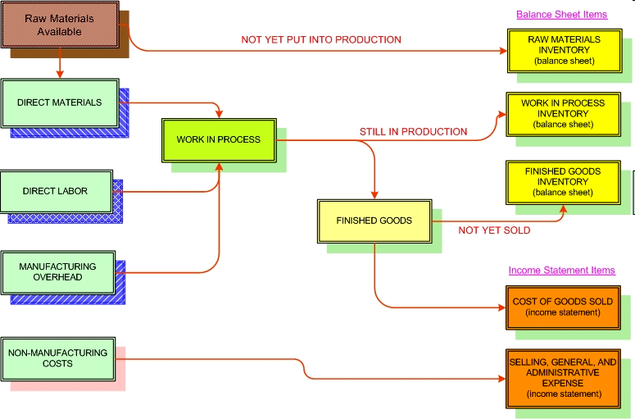
COST FLOW CONCEPTS FOR A MANUFACTURER
<number>/8

Slide 3




Cost of Goods Sold Components
Merchandising Company
Beginning Merchandise Inventory
Ending Merchandise Inventory
+
Cost of Goods Purchased
-
=
Cost of Goods Sold
Manufacturing Company
Beginning Finished Goods Inventory
Ending Finished Goods Inventory
+
Cost of Goods Manufactured
-
=
Illustration 1-5

Slide 4
MANAGEMENT ACCOUNTING
Determine which costs are involved in manufacturing
What is Cost of Goods Sold?
Raw Materials Inventory
Finished Goods Inventory
Beginning Raw Materials Inventory
Ending Raw Materials Inventory
Raw Materials Purchased
Direct Materials Used
Direct Labour
Beginning Finished Goods Inventory
Overhead
Work in Process Inventory
Beginning Work in Process Inventory
Manufacturing Costs
Ending Work in Process Inventory
Cost of Goods Manufactured
Ending Finished Goods Inventory
Manufacturing Costs Are Added to the Value of Inventory
COST OF GOODS SOLD
<number>/8

Slide 5

Cost of Goods Manufactured (COGM)
Cost of Goods Manufactured, (COGM), is a term used in managerial accounting that refers to a schedule or statement that shows the total production cost for a company during a specific period of time.
<number>/38

Slide 6
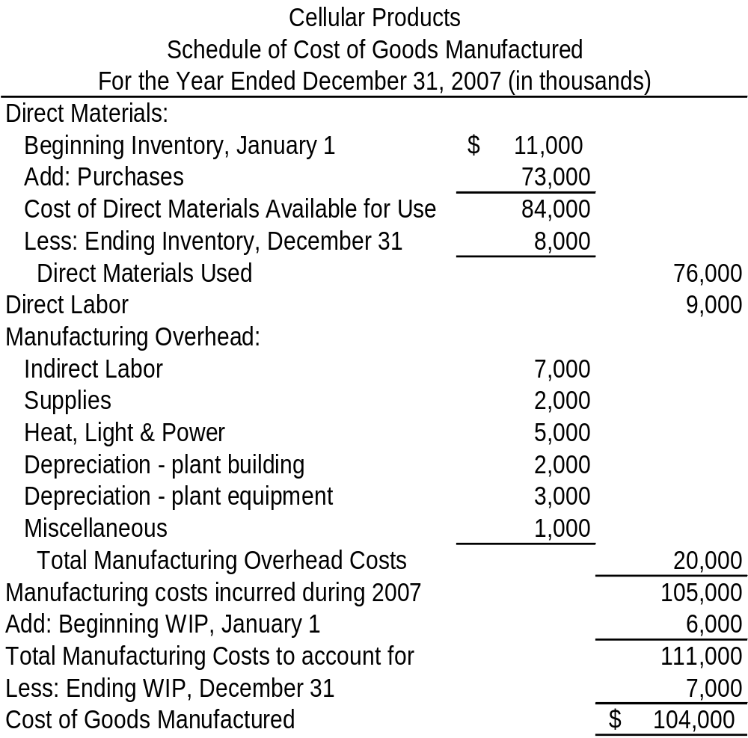
Cost of Goods Manufactured
Calculates the cost of Direct Materials Used
Accumulates the three product costs for the current period
Adjusts the current period manufacturing costs to account for units actually completed
<number>/8

Slide 7
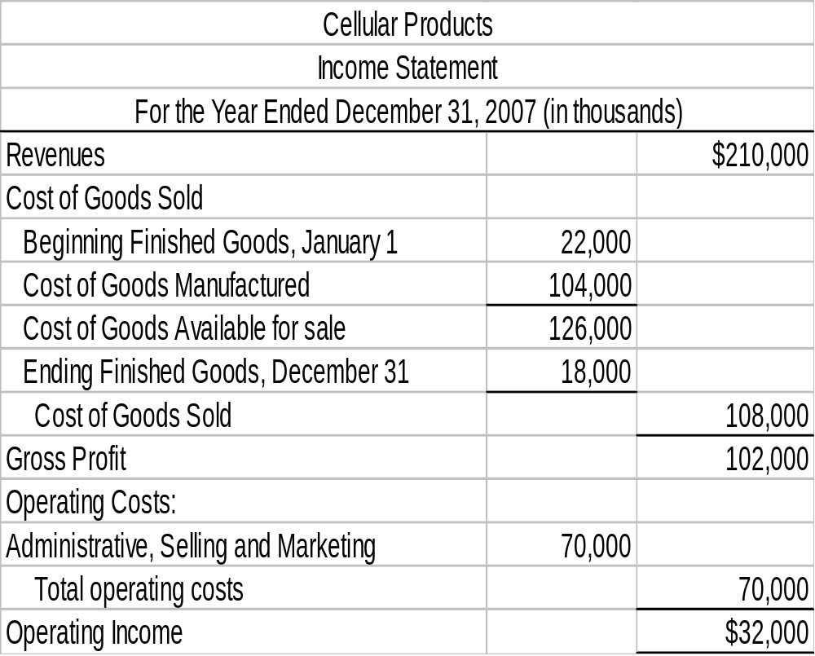
Income Statement
Figure carries forward from the Schedule of Cost of Goods Manufactured
Period Costs are expensed as incurred
<number>/8

Slide 8
End of Lecture 04
THANK YOU ALL…

